Slide 1

CS 533 INTRO TO DATA SCIENCE
Michael Ekstrand

Slide 2
INFERENCE AND ABLATION

Slide 3

Learning Outcomes
Make inferences about model accuracy
Understand interplay of cross-validation and inference
Use ablation studies to make inferences about feature or sub-model importance
Photo by Siora Photography on Unsplash

Slide 4

Train/Test Split
The Data
Training Data
Testing Data
Train model
Experiment with different model designs
Experiment with different features
Select hyperparameters
Evaluate Effectiveness
Significant?
One Way

Slide 5
Testing Effectiveness
For test data, we have:
Individual classifications, right or wrong
Single metric value (accuracy, precision, etc.) for each classifier
Can’t significance test a single value!

Slide 6
Testing Objectives
Does my classifier perform better than benchmark value?
What is the precision of my estimated classifier accuracy?
Confidence interval
Does classifier A perform better than B?
P-value
Confidence interval for the difference

Slide 7
Test Samples: Confidence Intervals
Solution 1: treat each test item as a binary measurement
If metric denominator from test data: Wilcox confidence interval
statsmodels: proportion_confint (with method=‘wilson’)
Works for accuracy, FPR, FNR, recall, specificity
Any metric:
Bootstrap the test samples
Compute metric from bootstrap samples

Slide 8
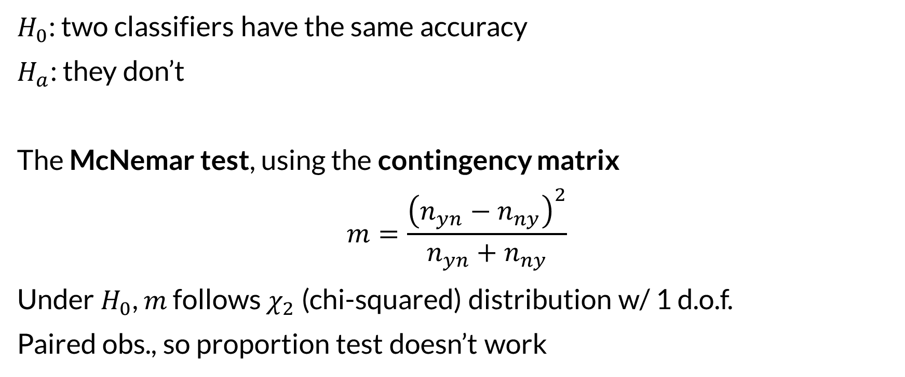

P-Value for Accuracy
$H_{0}$: two classifiers have the same accuracy
$H_{a}$: they don’t
The McNemar test, using the contingency matrix
$$m=\frac{{\left(n_{yn}−n_{ny}\right)}^{2}}{n_{yn}+n_{ny}}$$
Under $H_{0}$, $m$ follows $χ_{2}$ (chi-squared) distribution w/ 1 d.o.f.
Paired obs., so proportion test doesn’t work
 | C2 Right | C2 Wrong
C1 Right | 55 | 1
C1 Wrong | 0 | 24

Slide 9
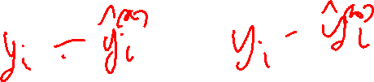
Testing Regression
For regression, each sample is a continuous measurement of the model’s prediction error.
Use paired t-test or appropriate bootstrap

Slide 10
Repeated Testing
With repeated cross-validation, we can compute a t-statistic
Run 5 times
Each time, do 2-fold cross-validation
See reading.
Simple cross-validation not great– too much non-independence
Repeated test sampling unreliable – too much non-independence

Slide 11
Cross-Validation and Train/Test Split
Cross-validation sometimes used for final eval
Allows data leakage – what did you do your model & feature selection on?
Good for:
Limited engineering – just see how well the model works
Model and feature design – when done on training data

Slide 12
Understanding Performance & Behavior
Suppose you are detecting spam with:
Text features
Metadata features
URL features
URL reputation model
Sender reputation model
What makes it work?

Slide 13
Ablation Studies
An ablation study examines impact of individual components
Turn each off in turn
Measure classification performance
Lets you see how much each component contributes
Do use results for production decisions, future work
Do not use results to revisit model design (in this trial)

Slide 14

Wrapping Up
Inference for classifier performance is not immediately straightforward.
Several techniques helpful.
Be careful about data leakage. Sometimes tradeoffs are needed.
Photo by Bianca Ackermann on Unsplash

